Slide 1
Chain
Noah Malhi
Prashant Kumar
Quentin Jimenez
Advisors:
Dov Kruger
Raghav Daga

Slide 2
Problem Statement
The String Class: - Array based object for streaming char - Insertion becomes a problem for large objects
Chain is an efficient tree structure for reading extremely large files.
Chain is a hybrid concept by Prof. Dov Kruger.
Leaves of the tree are lines, and each individual line is a conventional string.
Editing strings is incredibly inefficient when they are extremely large
There are solutions, such as rope, to more efficiently store and edit strings, but it is impractical to store an large files in a tree structure
Instead of representing characters as leaves, the chain structure uses lines of characters stored in sequential order in a pool of memory
This diminishes the number of pointers required, allowing for simpler storage and access
Limitations include memory allocation, which can be complex for large files

Slide 3
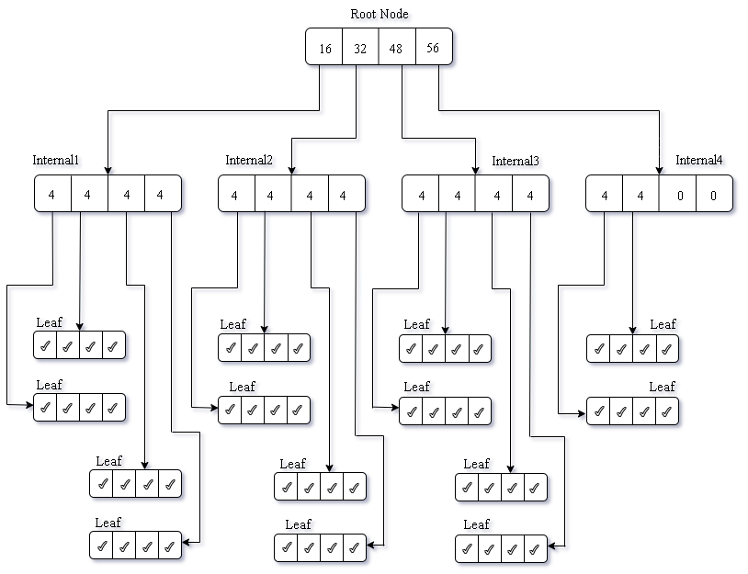
Structure
M-ary Trees.
Rules: at most m children Special cases: binary , ternary tree
Root Node- Pointer to internal nodes counter for #lines
Internal Nodes- Pointer to internal/leaf counter for #lines
Leaf Nodes Pointer to String (which is a line)

Slide 4
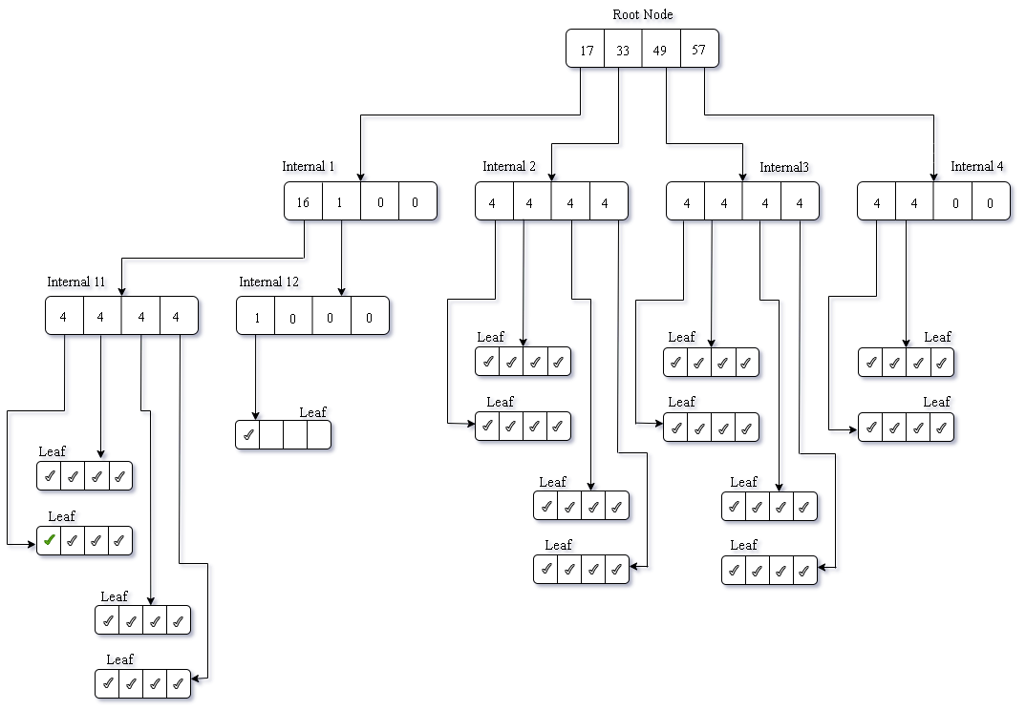
Insert start
Check space in Internal1
Split Internal1
Insert at pos1
Shift everything to right

Slide 5
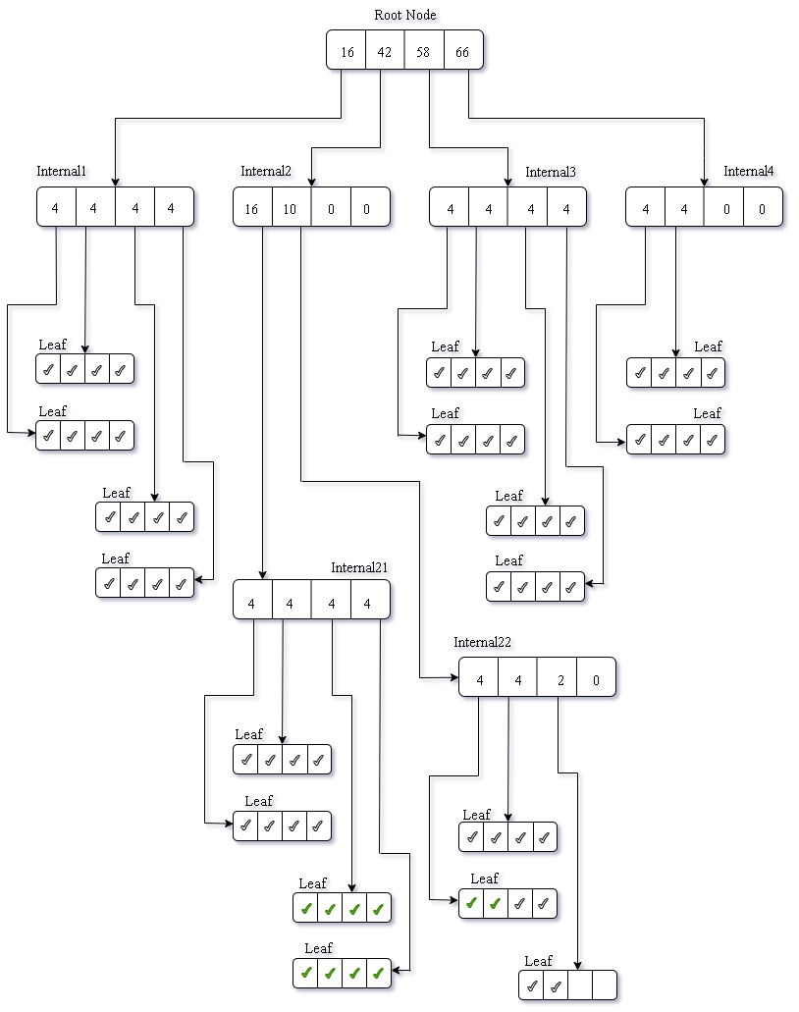
Insert middle
Insert 10 lines at pos 25

Slide 6
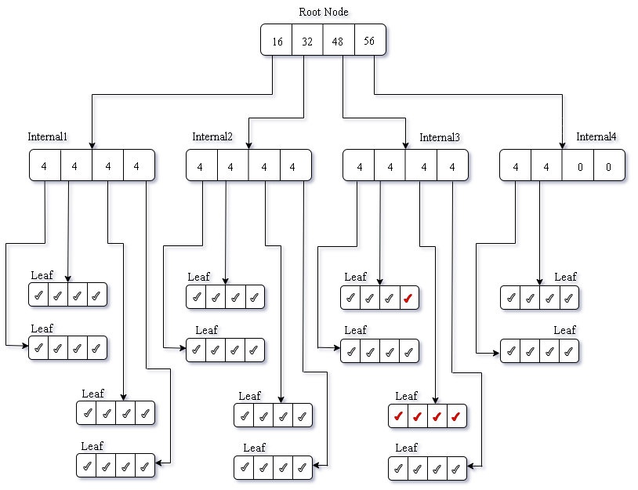
Delete-1
Delete 5 lines at pos 40
Removes strings from requested positions
Moves leaves up the tree to the correct positions
Clears last leaves and updates count values

Slide 7
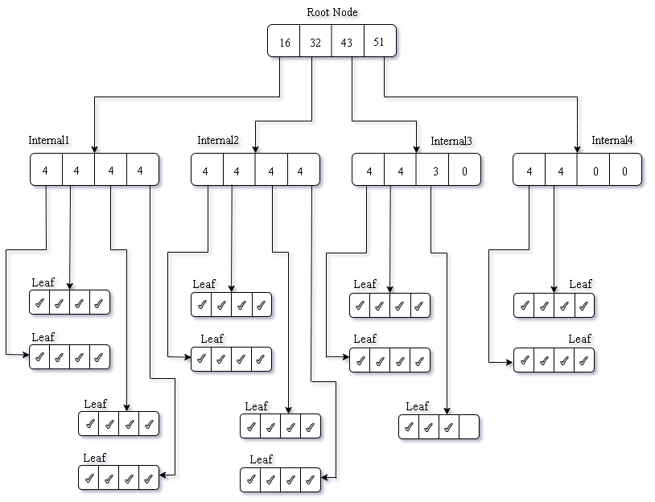
Delete-2

Slide 8
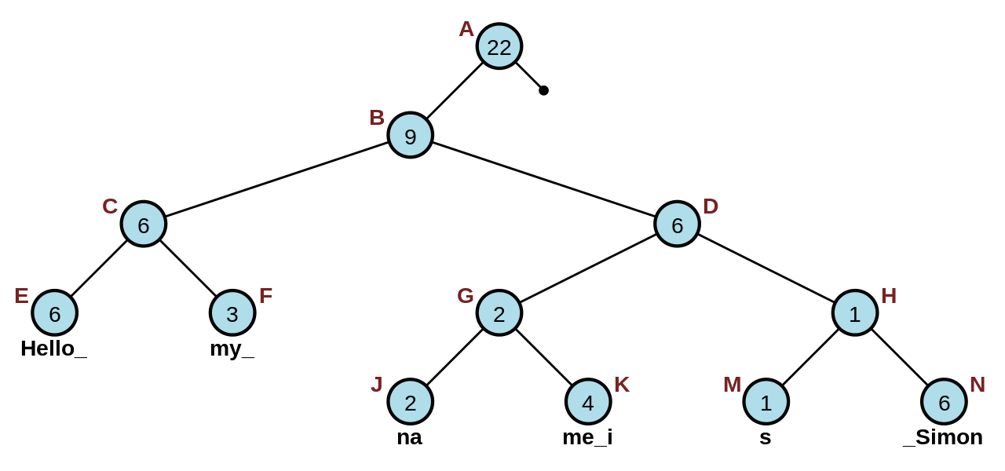
Literature
Ropes: Boehm and Russ
Binary tree
Leaf nodes hold strings
Internal Nodes hold length of the strings to the left
Sample rope: (image: wikipedia) String: Hello my name is Simon
Ropes are used to store strings and allow for faster processing of long strings
Rope uses a tree structure with weights to represent the number of characters stored to the left of the node
Efficient structure allows O(logn) for insertion, deletion and indexing

Slide 9
How are we different?
Each line is a node, so we use about an order of magnitude lower number of nodes.
Ropes are binary trees. The depth cannot be controlled.
Chain can be higher order trees, leading to very fat tree structures.

Slide 10
Progress
Issues, TODO

Slide 11
Complexity Analysis
Assumption: Each word in English language is 8-10 char. Average line length is 8-10 words.
String Size= N characters
Rope- n nodes
M-ary Tree with n nodes (n is diff for rope and chain)
Example: 100MB text file 1 char = 1 byte 1MB = 1 millions char 100MB = 100 million char/ 10 million words/ 1 million lines.
#nodes_rope ~ 10 million, #nodes_chain ~ 1 million
 | String | Rope | Chain
Insert | O(N) | Olog(n) | Olog(n)
Delete | O(N) | Olog(n) | Olog(n)
Search | O(N) | Olog(n) | Olog(n)

Slide 13
Thank You!
Questions?
Noah Malhi
Prashant Kumar
Quentin Jimenez

